Slide 1
My experience using Git and GitHub
Understanding the basis of git and GitHub workflow, I discovered my work was more organized, easy to manage and I can easily keep track of my files and progress through the projects I will be developing. It took me some time to understand them, some repetitive tasks, but come to think of it, nothing good comes easy. I had to familiarize with some terms like ‘push’, ‘commit’, ‘add’ and ‘clone’ Now, I can work alone and collaborate effectively with my capstone group using git without any issues. There are concepts that I still need some clarification like branching and the branch-naming conventions. But it will be a work in progress that will be happening soon enough to be ready to support my group classmates in an effective way with our Capstone Project. And this is a tool that I will be using for other works and projects besides this one.

Slide 2
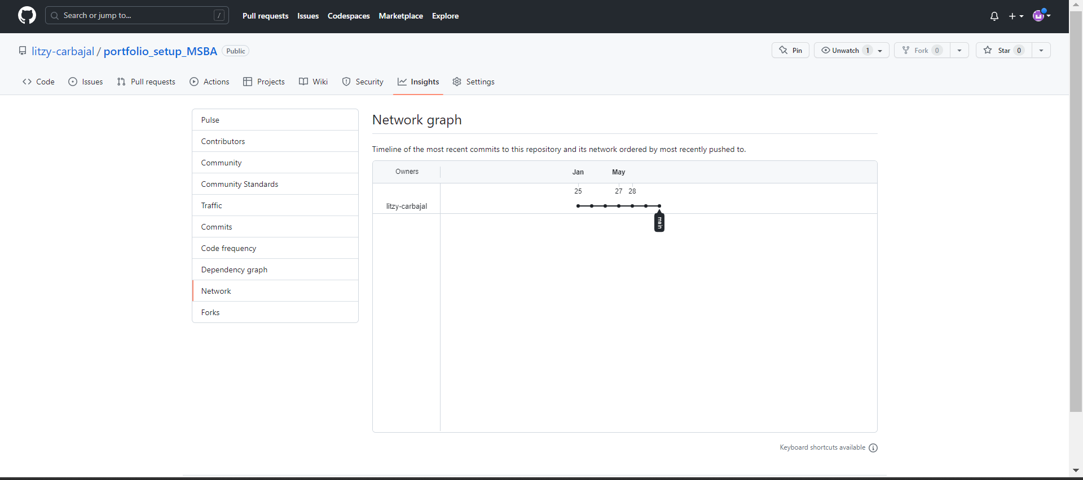
Screenshot of network graph

